Slide 1
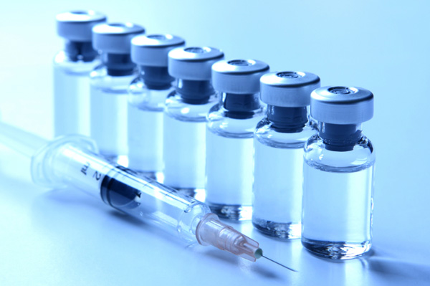
To vax or not? A survey of global health indicators
Shuja Sajjad
Kyaw Lynn
Jose Ramses Sanchez

Slide 2


The current debate
Ideology vs Science
Implications?

Slide 3
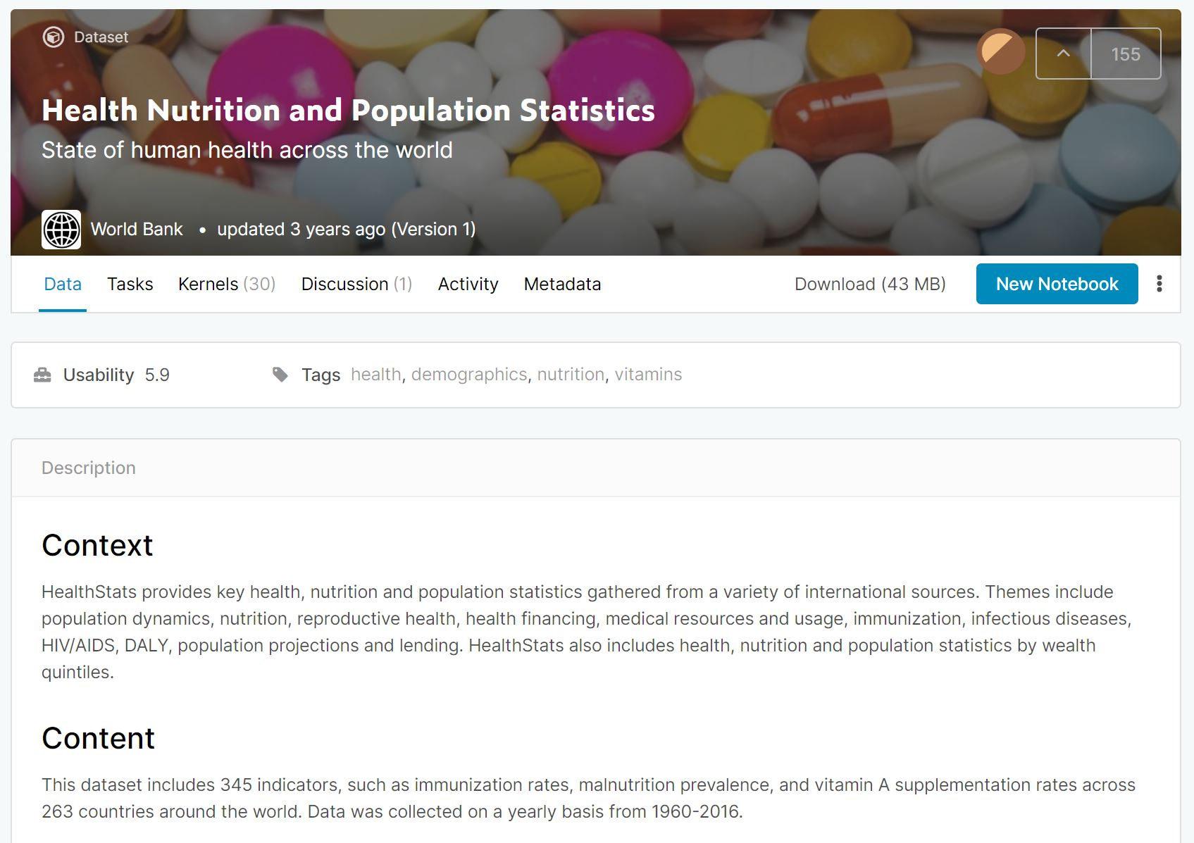
The data hunt
∙ Sourced from the World Bank
∙ Over 300 various health indicators
∙ Data of 273 countries
∙ Historical data beginning from 1960
(availability varied)

Slide 4

Search for a cure disease
Measles
∙ Even though a safe and cost-effective vaccine is available, in 2018, there were more than 140,000 measles deaths globally. (WHO)¹
∙ Most worldwide deaths occur to children under the age of five. (WHO)¹
¹https://www.who.int/news-room/fact-sheets/detail/measles

Slide 5
Questions to investigate
Is there a relationship between measles vaccination rates and infant mortality trends in the last decade?
Also, do economic trends (measured by Gross National Product (GNP)) coincide with measles vaccination rates in the last decade?
Countries to analyze: USA, China, Germany, and Brazil.

Slide 6
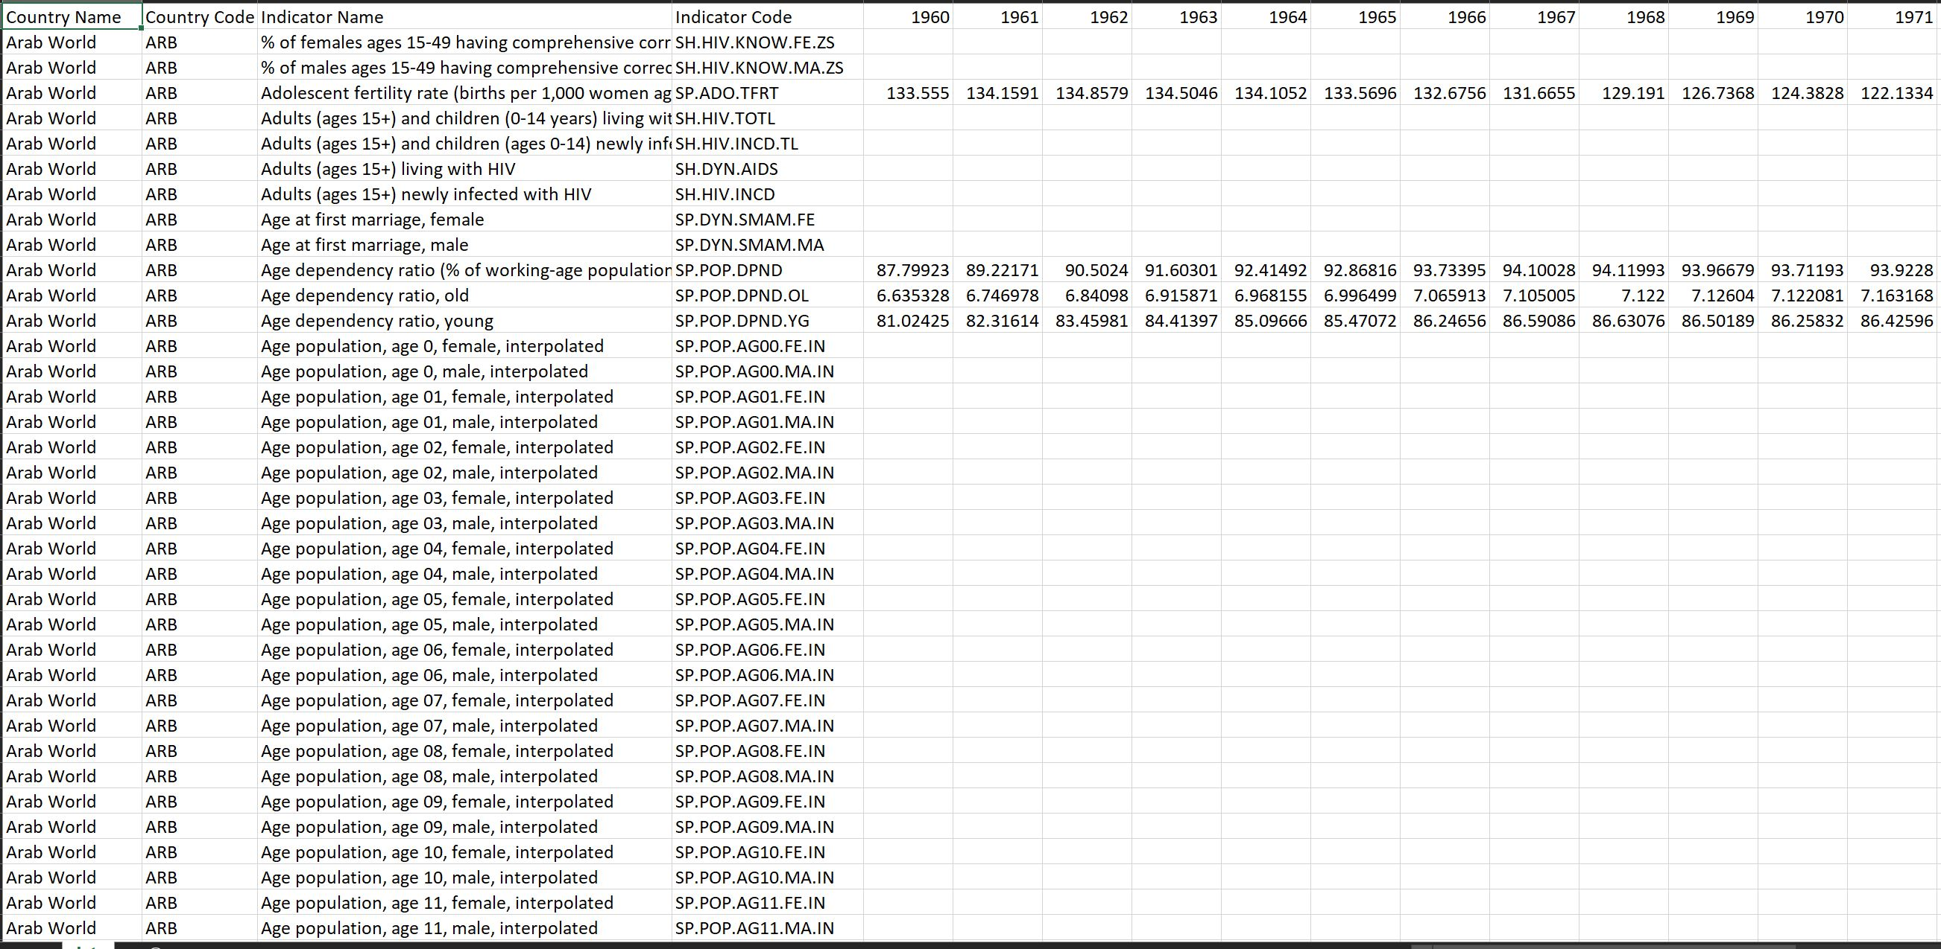
Initial Data cleaning

Slide 7
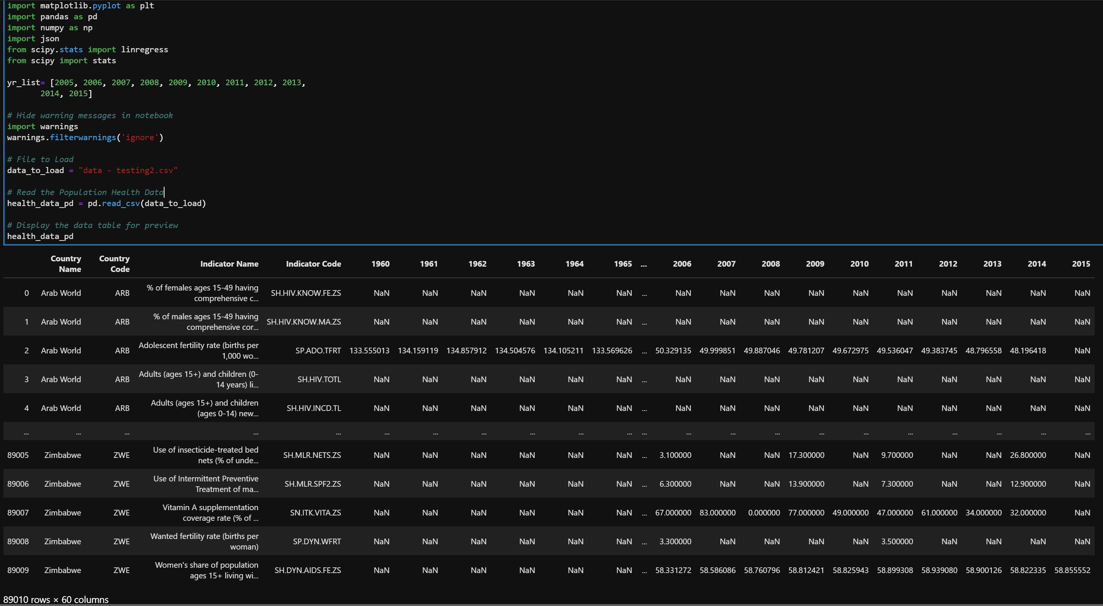
Initial Data cleaning (USA)

Slide 8
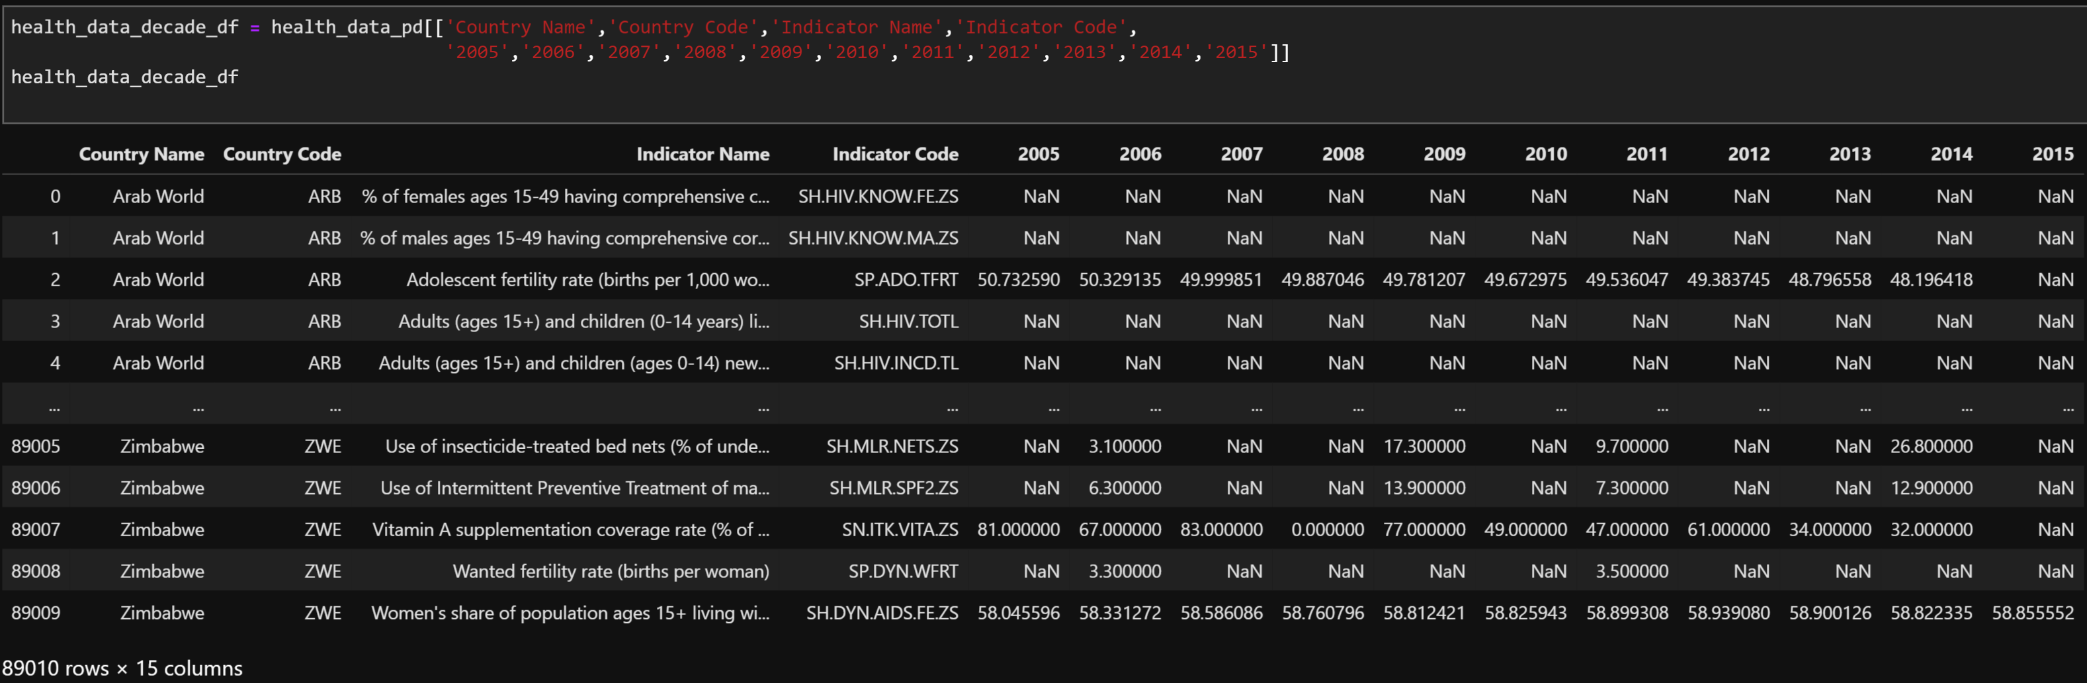
Initial Data cleaning (USA)

Slide 9
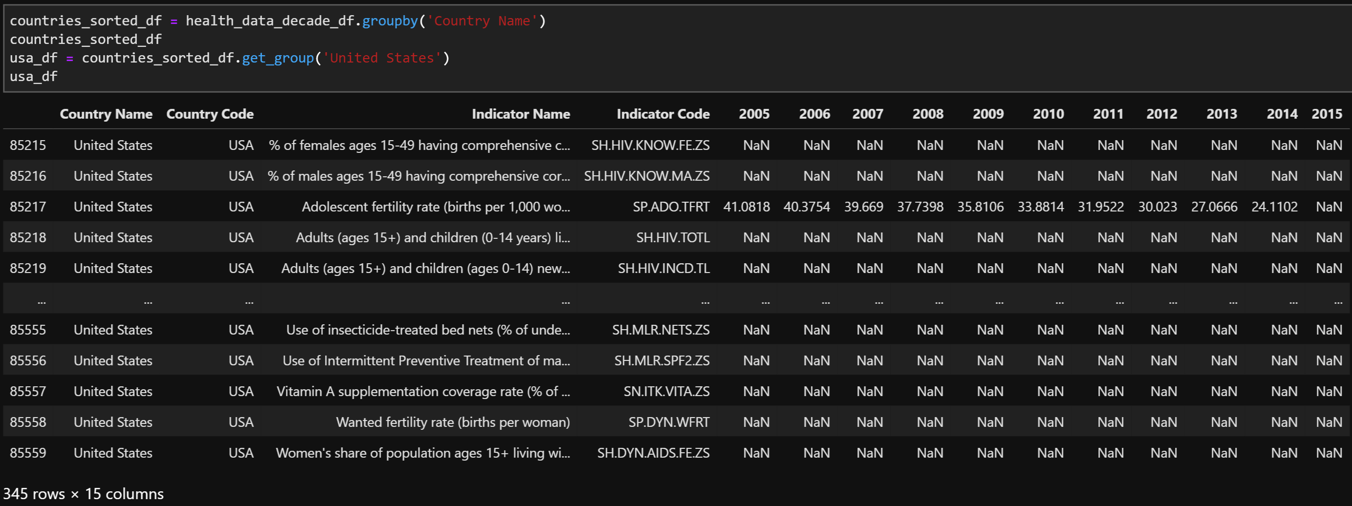
Initial Data cleaning (USA)

Slide 10
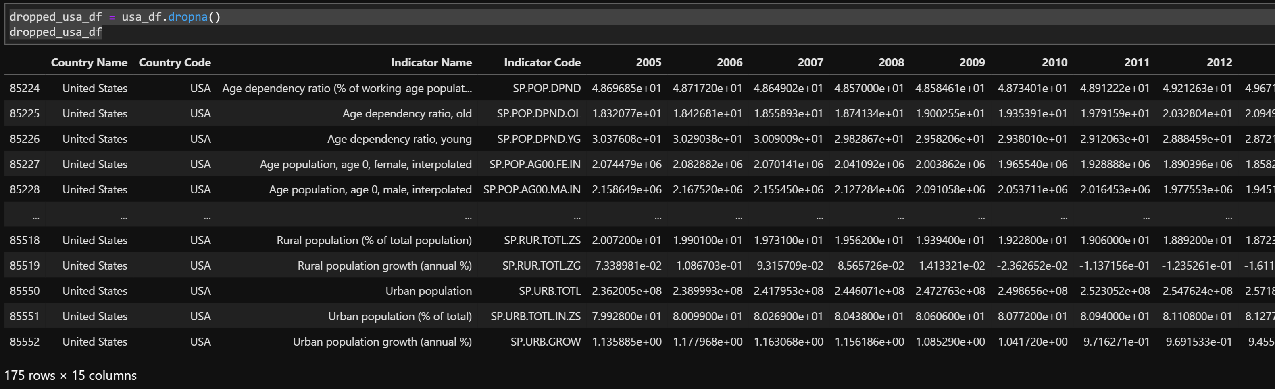
Initial Data cleaning (USA)

Slide 11
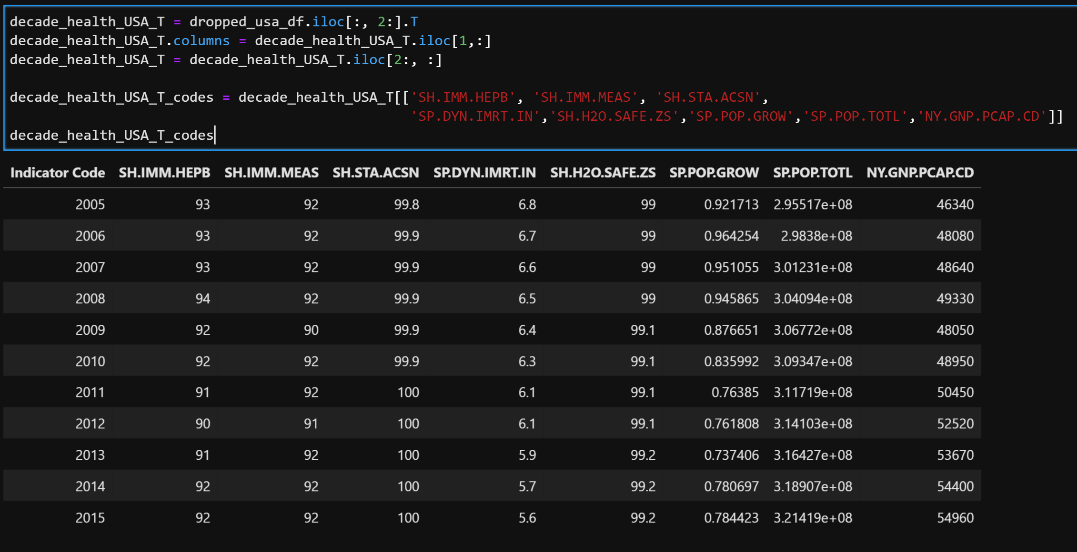
Initial Data cleaning (USA)

Slide 12
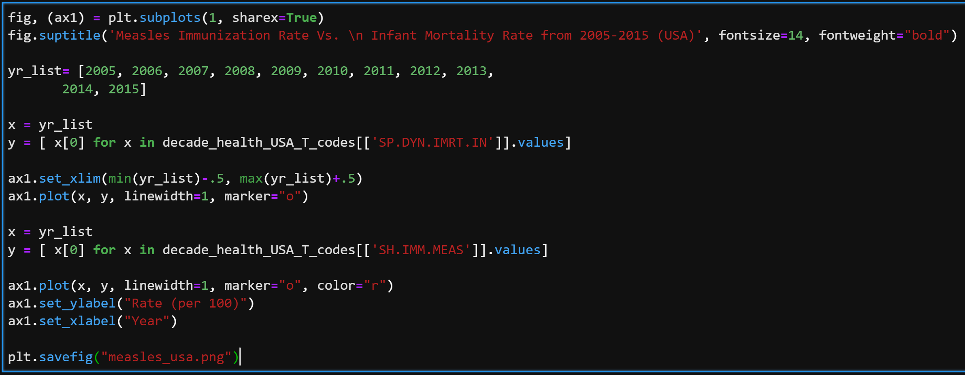
Initial Data cleaning (USA)

Slide 13
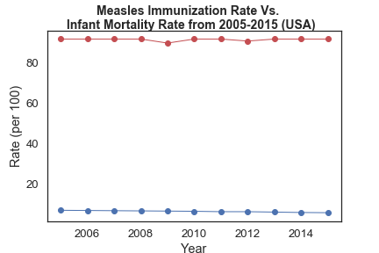
Initial Data cleaning (USA)

Slide 14
Data analysis

Slide 15
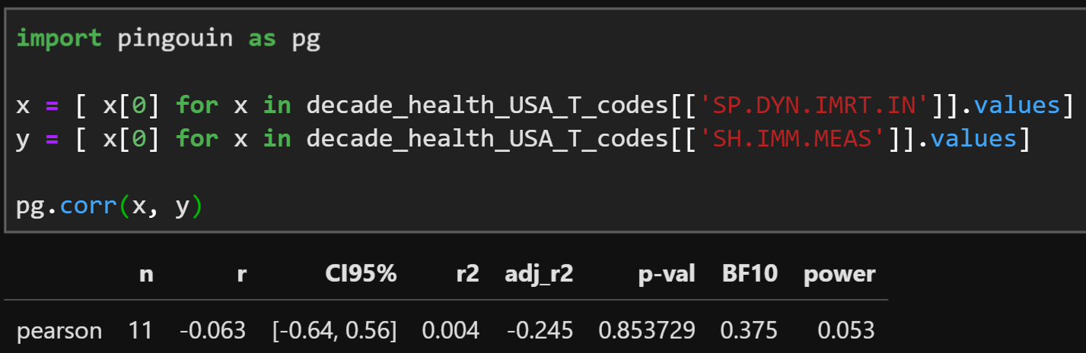
Data Analysis Immunization rates vs infant mortality
*Note negative r value*

Slide 16
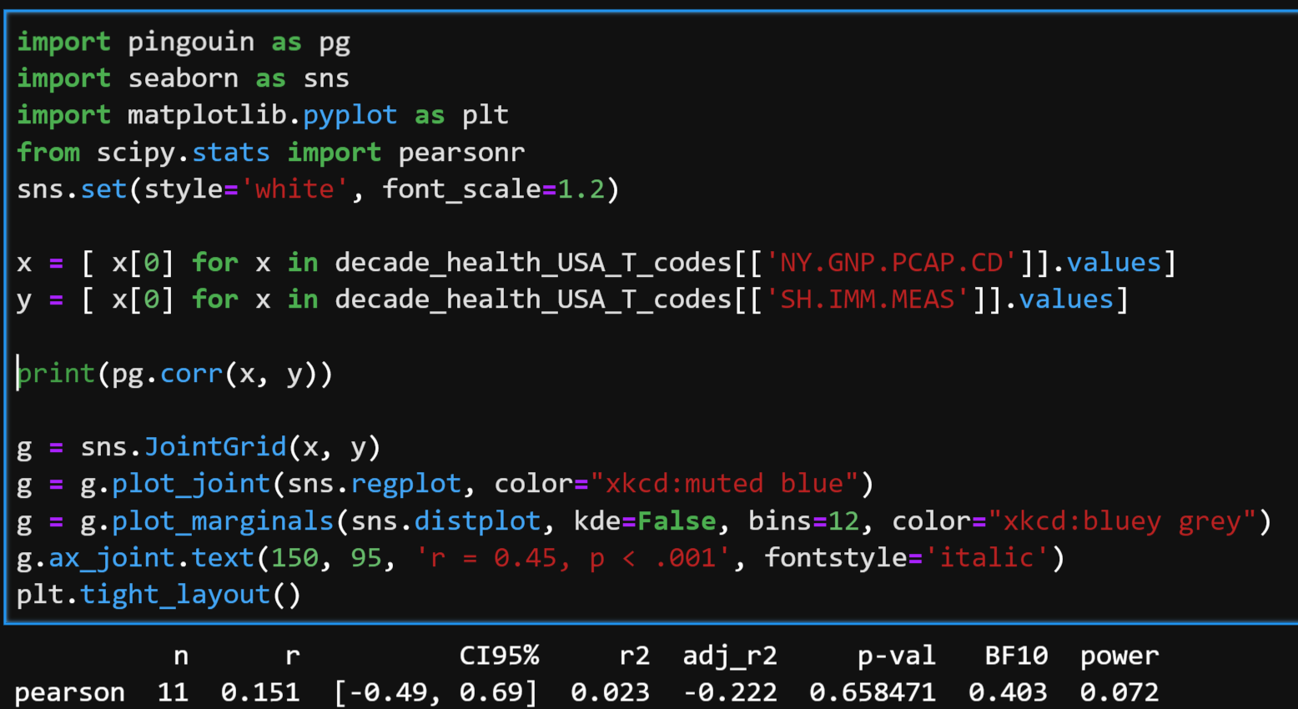
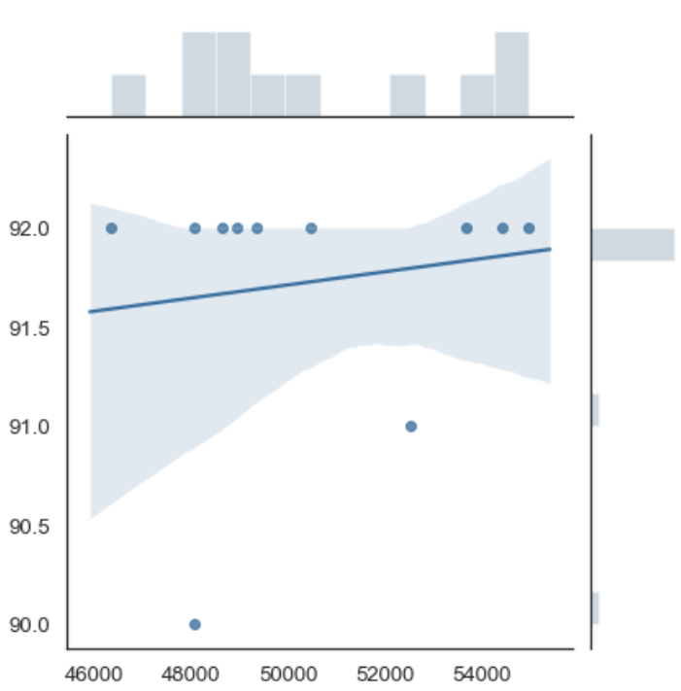
Data analysis GNP and immunization rates
*Note positive r value*
X axis – GNP (in millions of $)
Y axis – Measles Immunization Rate

Slide 17
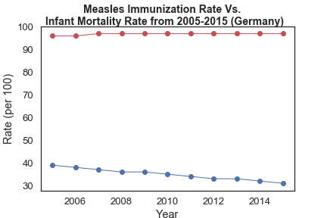
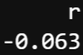
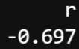
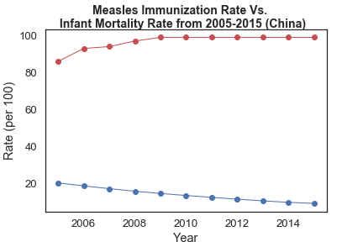
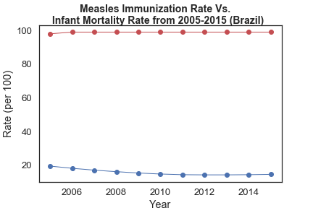
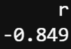
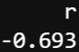
Immunization and infant mortality correlation

Slide 18
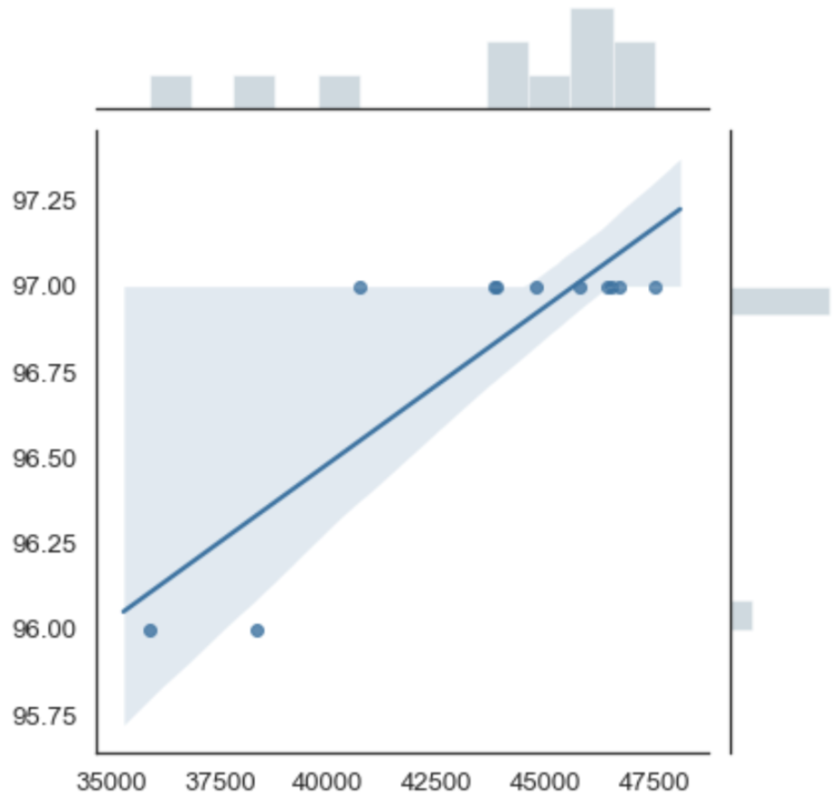
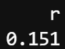
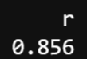
gnp and Immunization rate correlation
USA
Germany
X axis – GNP ($)
Y axis – Measles Immunization Rate

Slide 19
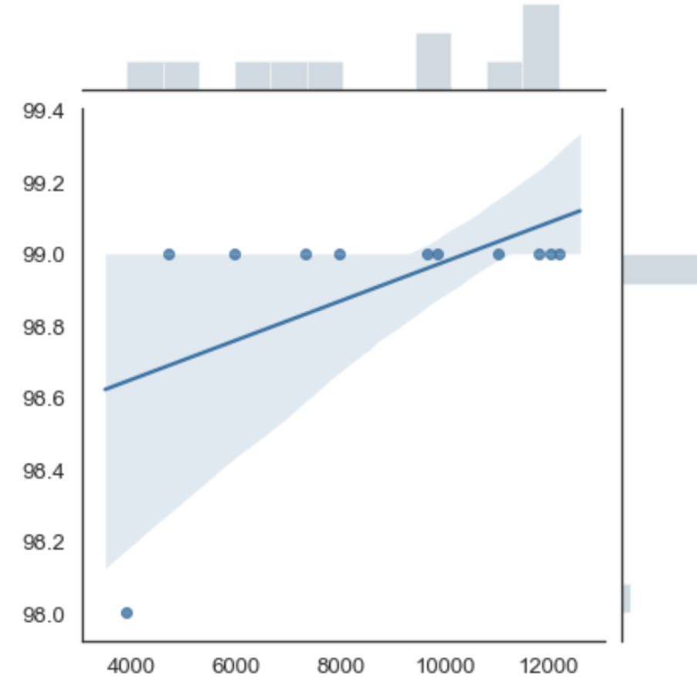
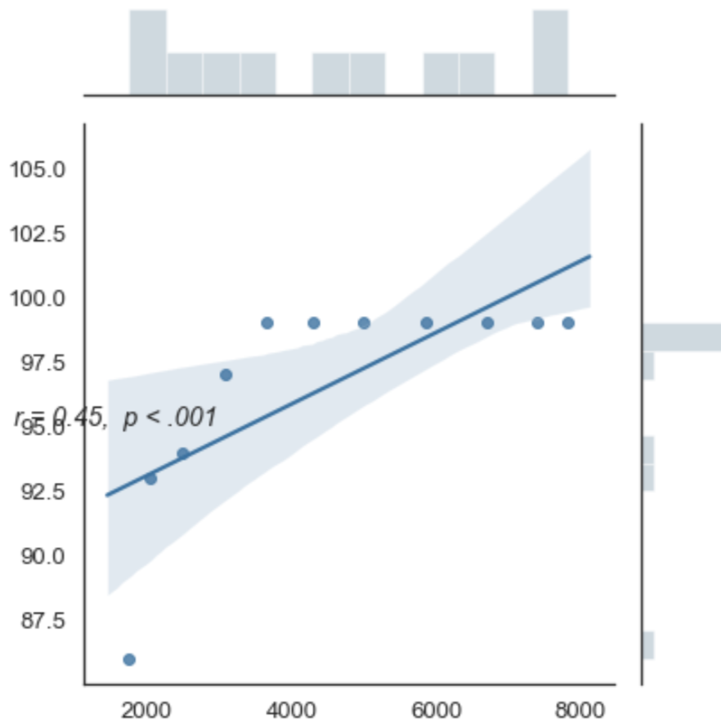
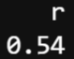
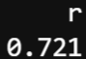
gnp and Immunization rate correlation
Brazil
China
X axis – GNP ($)
Y axis – Measles Immunization Rate

Slide 20

Conclusions
But.....

Slide 21
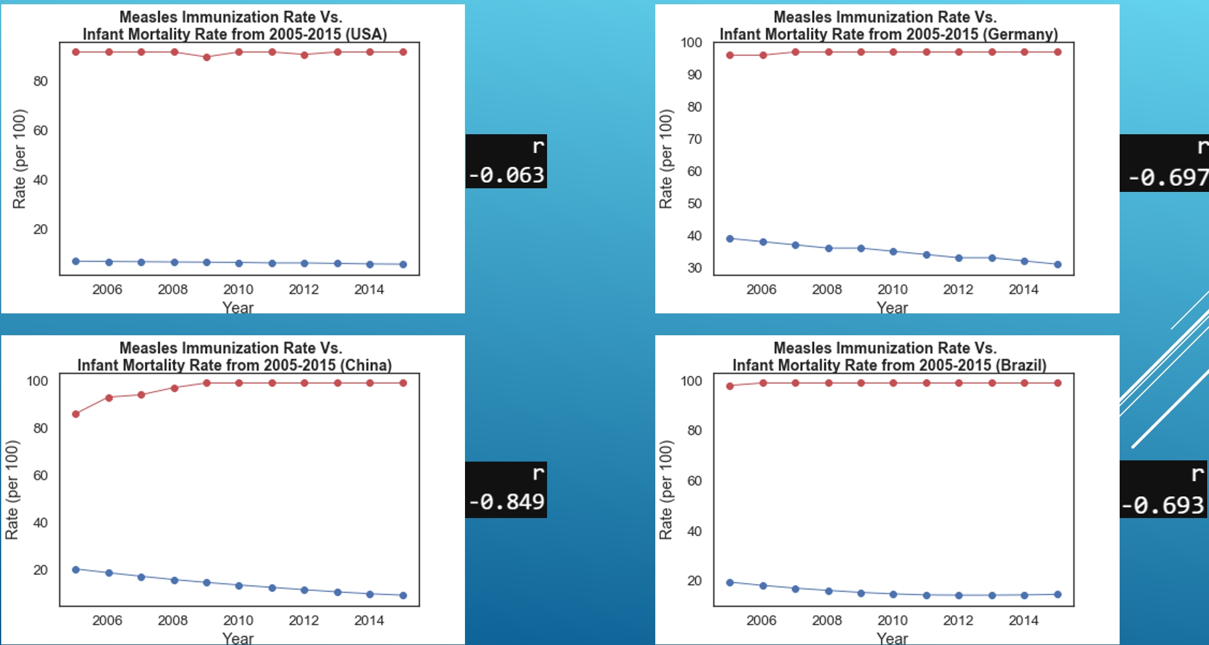
Conclusions
All four of the countries analyzed had negative r values, indicating that while immunization rates increased, infant mortality rates decreased.

Slide 22
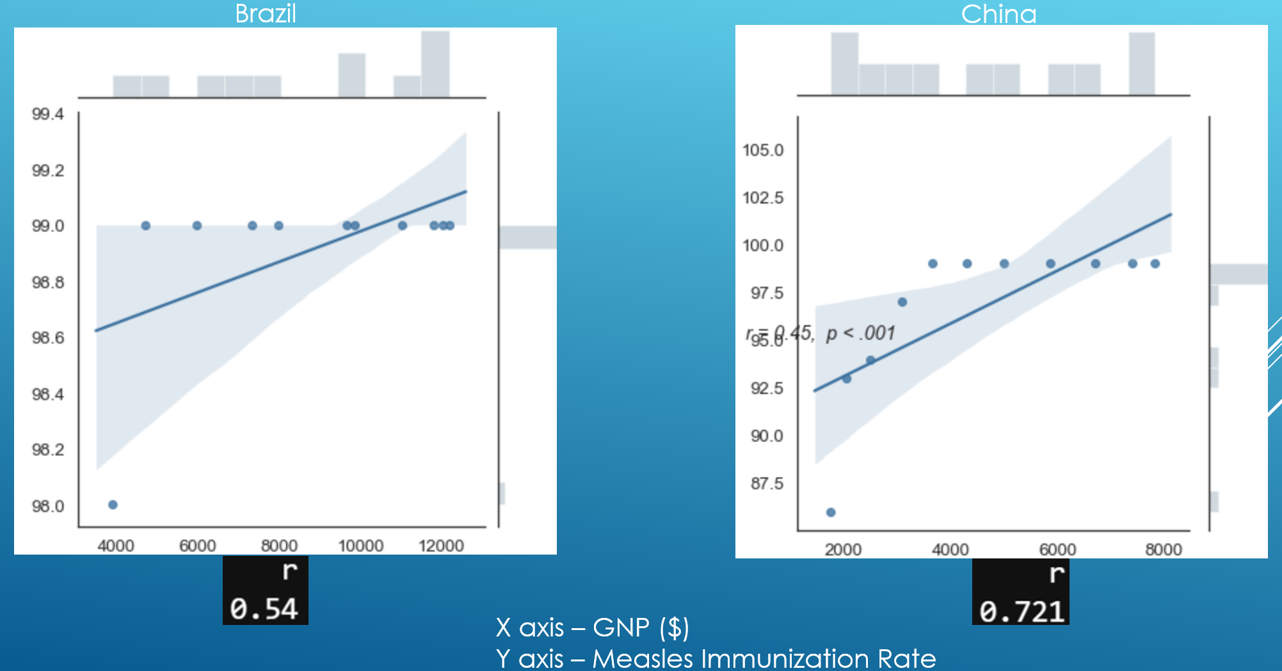
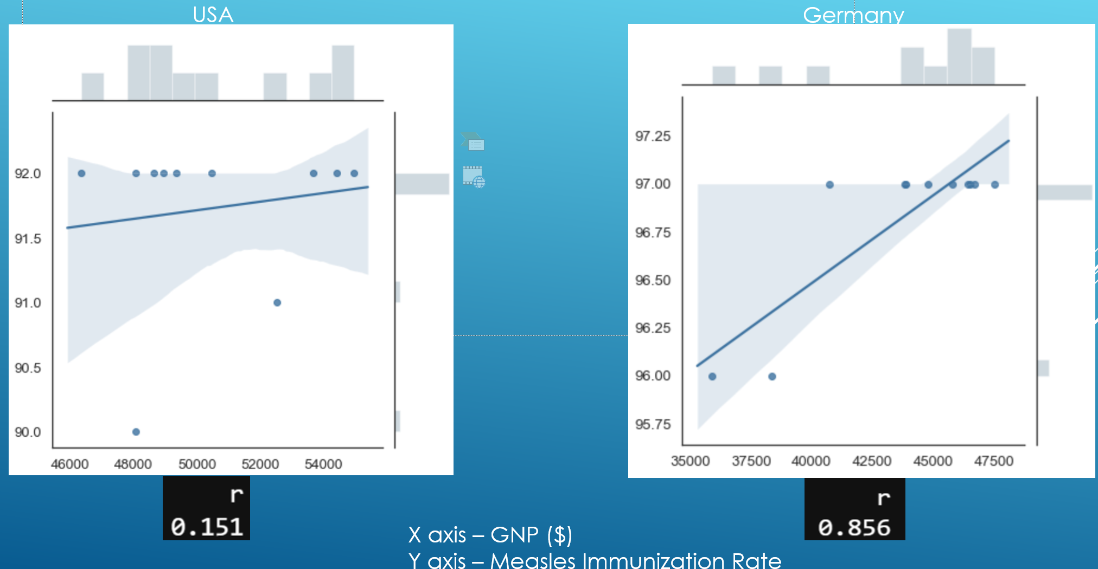
gnp and Immunization rate correlation
All four of the countries analyzed had positive r values, indicating that while GNP rates increased, immunization rates also increased.

Slide 23
Makes sense – right?
↑ Immunization rates
↓ Infant mortality rates
↑ economic robustness (GNP)
↑ Immunization rates
**BUT further analysis required to firmly establish causes and factors**

Slide 24
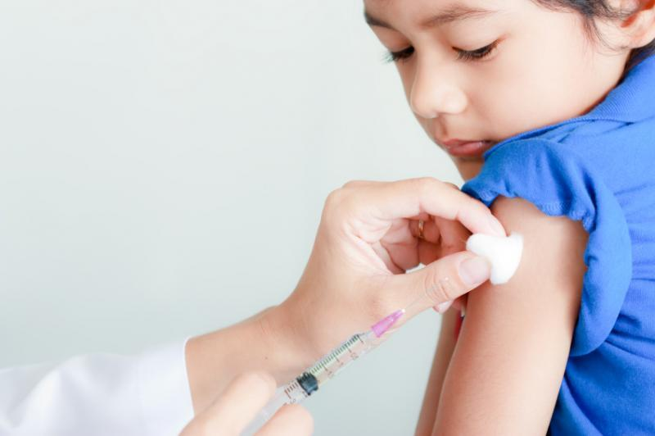
Questions? Comments?

